Slide 1
Spread Spectrum
Analog or digital data
Analog signal
Spread data over wide bandwidth
Makes jamming and interception harder
Frequency hoping
  Signal broadcast over seemingly random series of frequencies
Direct Sequence
  Each bit is represented by multiple bits in transmitted signal
  Chipping code

Slide 2
Spread Spectrum Concept
Input into channel encoder
  Produces narrow bandwidth analog signal around central frequency
Signal modulated using sequence of digits
  Spreading code/sequence
  Typically generated by pseudonoise/pseudorandom number generator
Increases bandwidth significantly
  Spreads spectrum
Receiver uses same sequence to demodulate signal
Demodulated signal fed into channel decoder

Slide 3
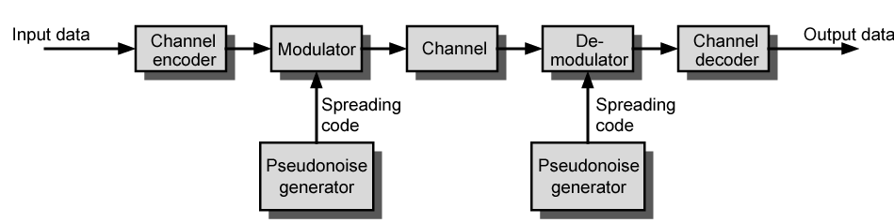
General Model of Spread Spectrum System

Slide 4
Gains
Immunity from various noise and multipath distortion
  Including jamming
Can hide/encrypt signals
  Only receiver who knows spreading code can retrieve signal
Several users can share same higher bandwidth with little interference
  Cellular telephones
  Code division multiple access (CDMA)

Slide 5
Pseudorandom Numbers
Generated by algorithm using initial seed
Deterministic algorithm
  Not actually random
  If algorithm good, results pass reasonable tests of randomness
Need to know algorithm and seed to predict sequence

Slide 6
Frequency Hopping Spread Spectrum (FHSS)
Signal broadcast over seemingly random series of frequencies
Receiver hops between frequencies in sync with transmitter
Jamming on one frequency affects only a few bits

Slide 7
Basic Operation
Typically 2^{k} carriers frequencies forming 2^{k} channels
Channel spacing corresponds with bandwidth of input
Each channel used for fixed interval
  300 ms in IEEE 802.11
  Some number of bits transmitted using some encoding scheme
    May be fractions of bit (see later)
  Sequence dictated by spreading code

Slide 8
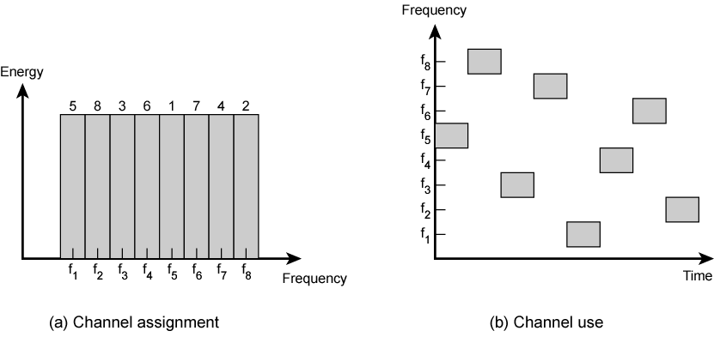
Frequency Hopping Example

Slide 9
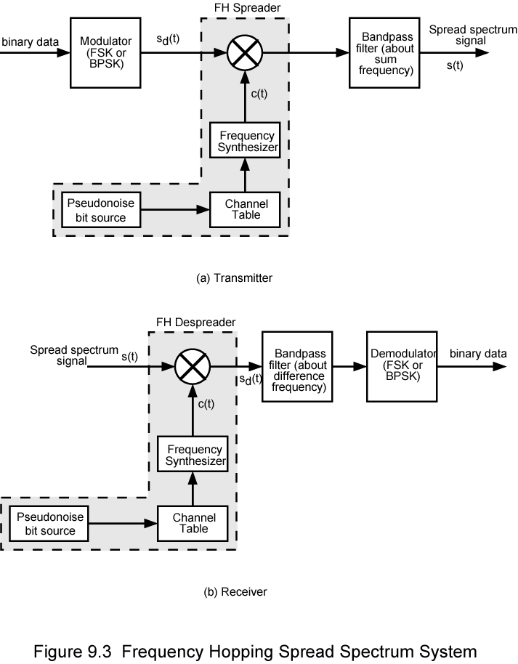
Frequency Hopping Spread Spectrum System (Transmitter) sdt is a resulting signal carrier frequency c(t)

Slide 10
Frequency Hopping Spread Spectrum System (Receiver)

Slide 11
Slow and Fast FHSS
Frequency shifted every T_{c} seconds
Duration of signal element is T_{s} seconds
Slow FHSS has T_{c} greater than > T_{s}
Fast FHSS has T_{c} less than< T_{s}
Generally fast FHSS gives improved performance in noise (or jamming)

Slide 12
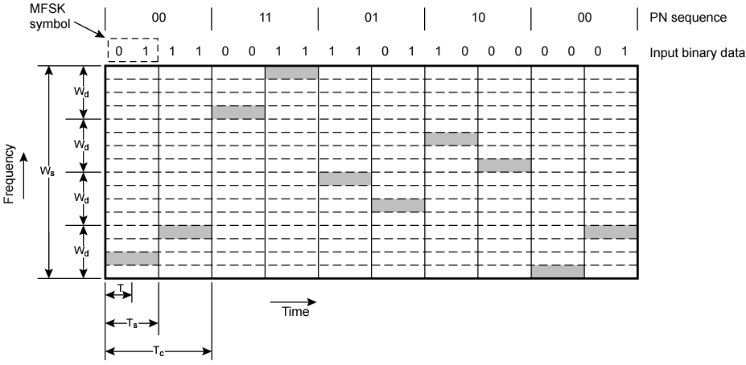
Slow Frequency Hop Spread Spectrum Using MFSK (M=4, k=2)
Here we have M = 4, which means that four different frequencies are used to encode the data input 2 bits at a time.

Slide 13
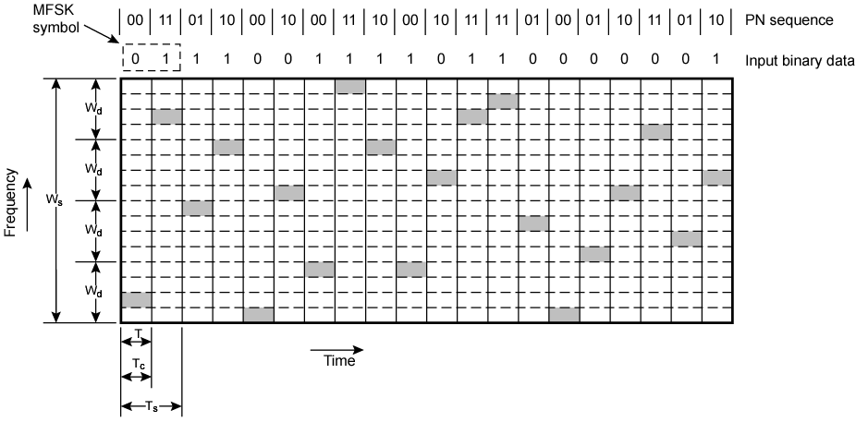
Fast Frequency Hop Spread Spectrum Using MFSK (M=4, k=2)

Slide 14
FHSS Performance Considerations
Typically large number of frequencies used
  Improved resistance to jamming

Slide 15
Direct Sequence Spread Spectrum (DSSS)
Each bit represented by multiple bits using spreading code
Spreading code spreads signal across wider frequency band
  In proportion to number of bits used
  10 bit spreading code spreads signal across 10 times bandwidth of 1 bit code
One method:
  Combine input with spreading code using XOR
  Input bit 1 inverts spreading code bit
  Input zero bit doesn’t alter spreading code bit
  Data rate equal to original spreading code
Performance similar to FHSS

Slide 16
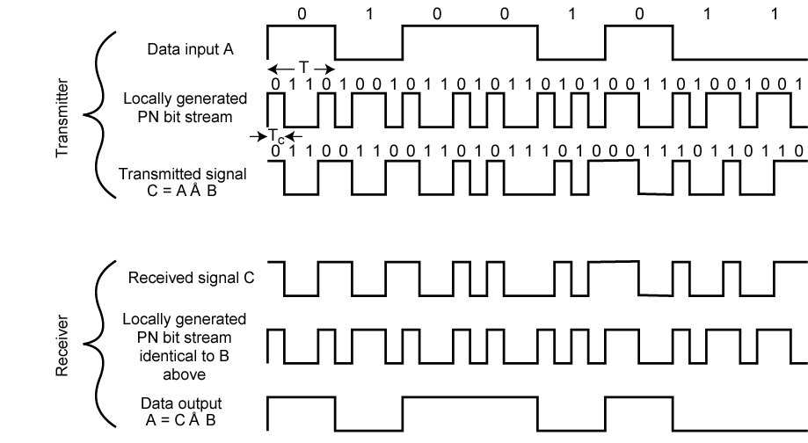
Direct Sequence Spread Spectrum Example

Slide 17
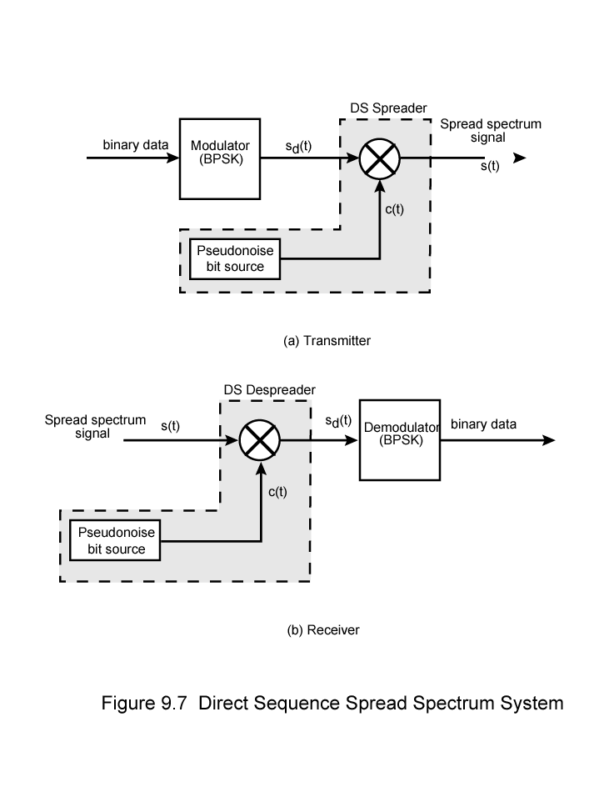
Direct Sequence Spread Spectrum Transmitter sdt is a resulting signal carrier frequency c(t)

Slide 18
Direct Sequence Spread Spectrum Transmitter carrier frequency c(t)

Slide 19
Bit rate
Baud rate
Goal in data communication is to increase the bit rate while decreasing the baud rate. Increasing the data rate increases the speed of transmission, decreasing the baud rate decreases the bandwidth requirement.

Slide 20
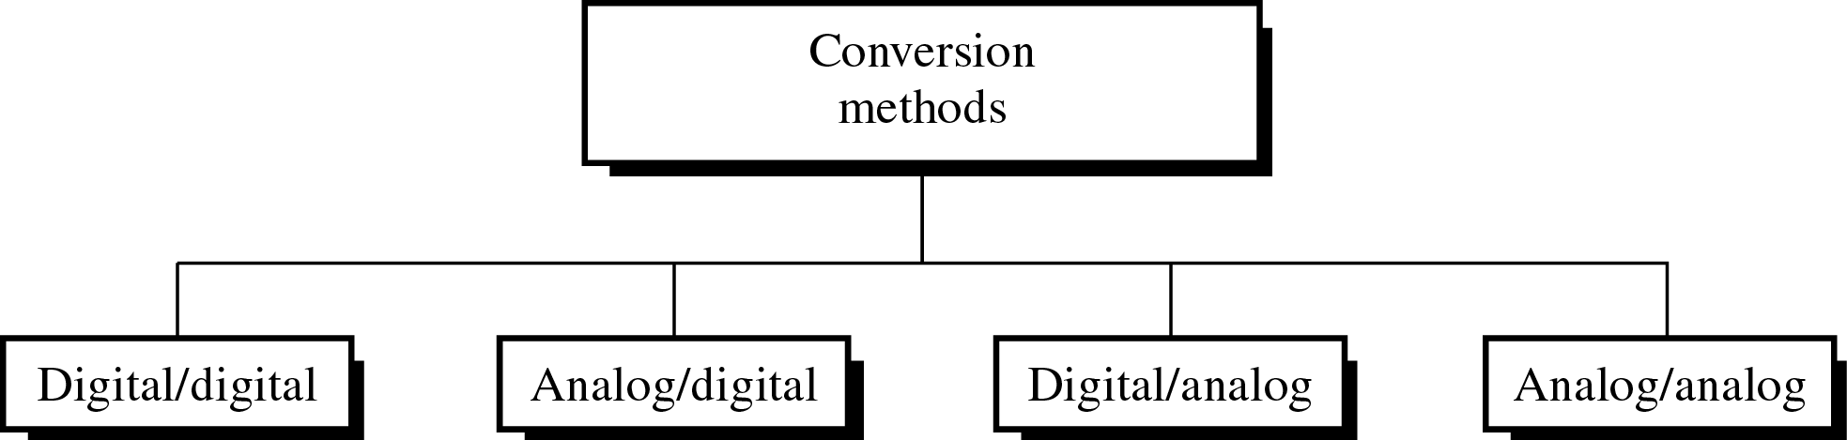
Figure 5-1
Different Conversion Schemes

Slide 21
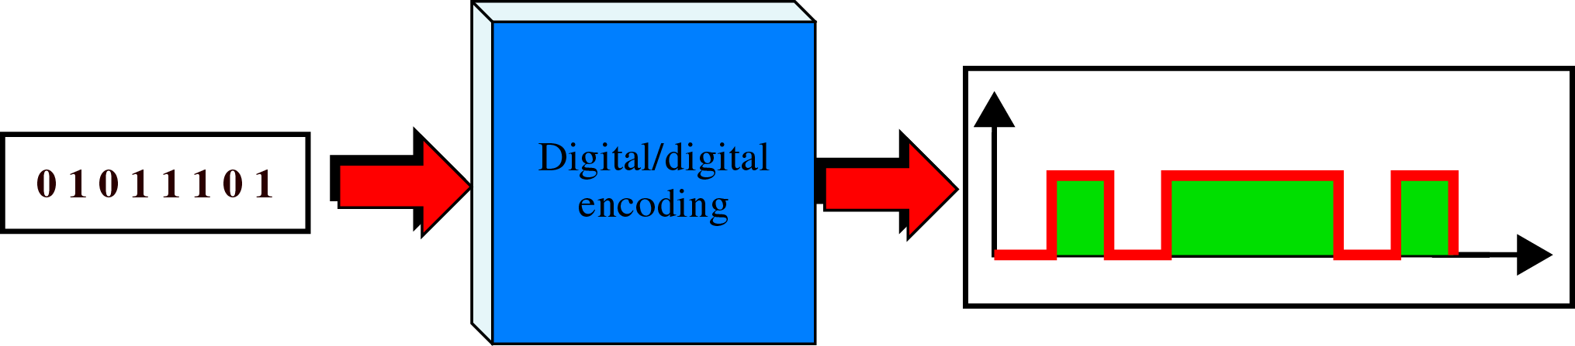
Figure 5-2
Digital to Digital Encoding

Slide 22
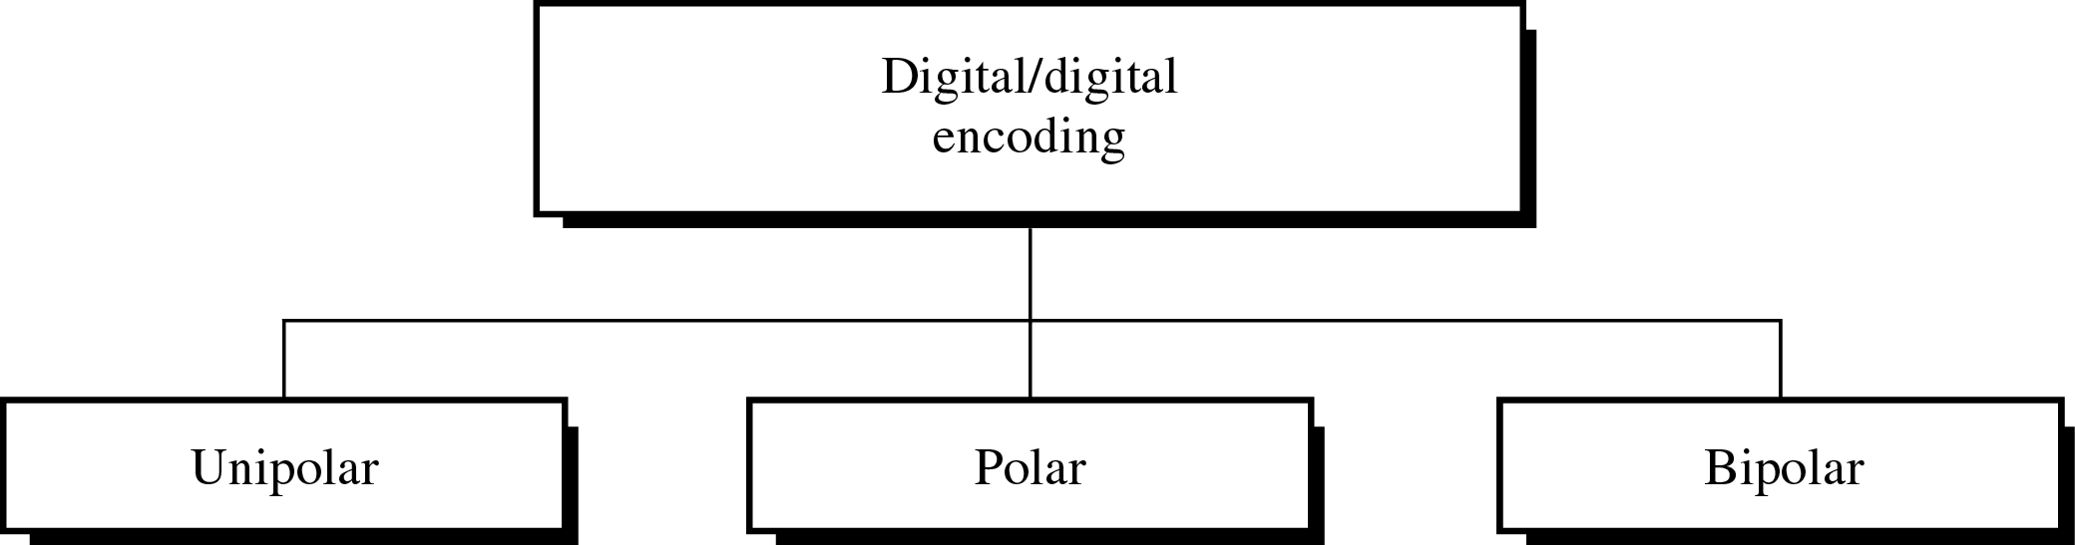
Figure 5-3
Types of Digital to Digital Encoding

Slide 23
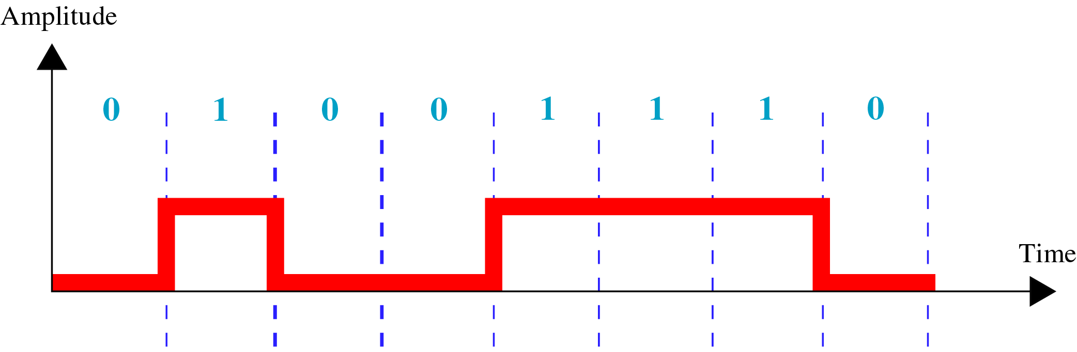
Figure 5-4
Unipolar Encoding

Slide 24
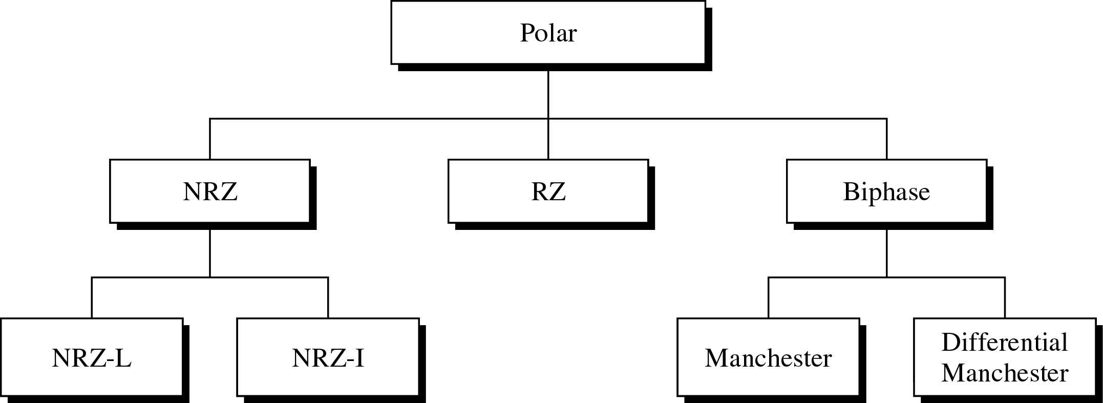
Figure 5-5
Types of Polar Encoding
NRZ (non return to zero)

Slide 25
Polar schemes
The voltages are on both side of the time axis.
NRZ (non return to zero)
NRZ-L : The level of the voltage determines the value of bit.
NRZ-I : the change in the level of the voltage determines the level of the bit. If there is no change, the bit is 0, if there is a change, the bit is 1.

Slide 26
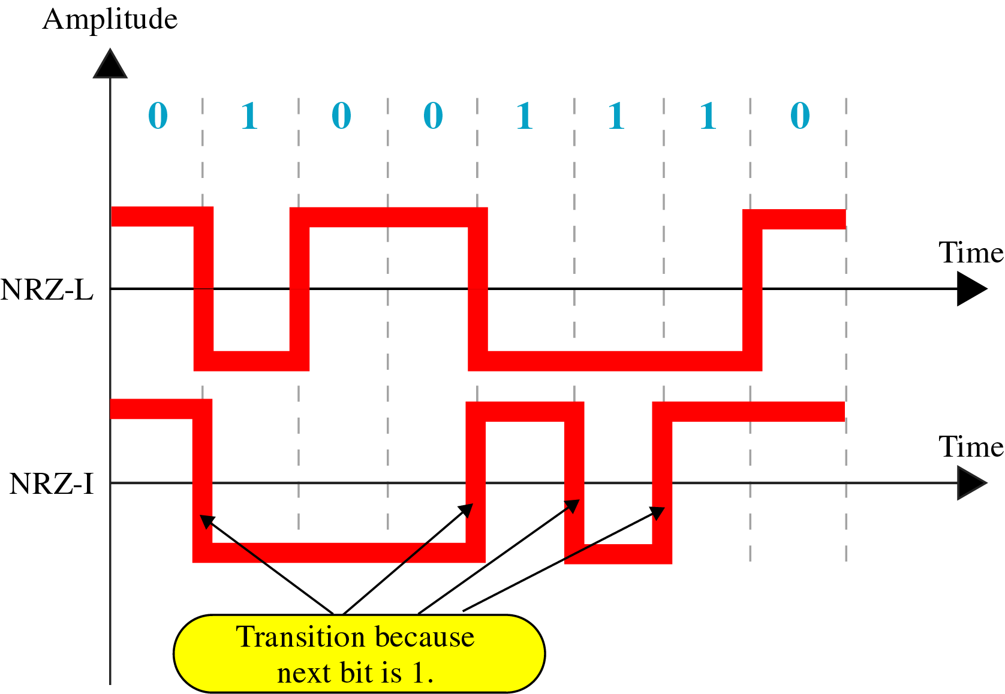
Figure 5-6
NRZ-L and NRZ-I Encoding

Slide 27
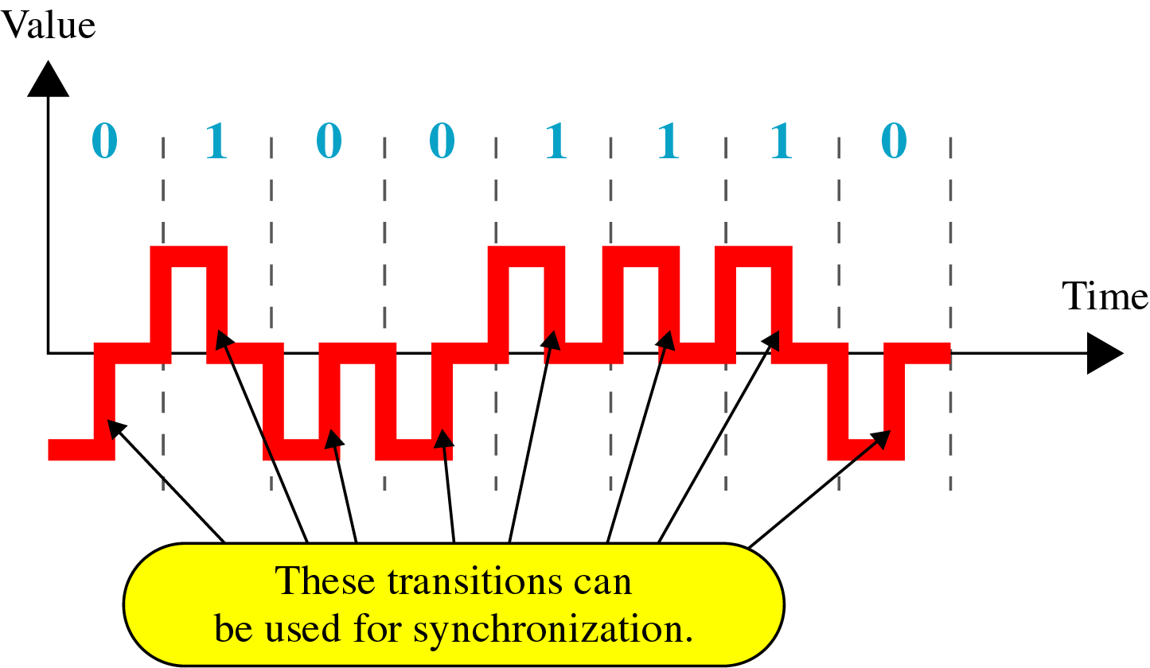
Figure 5-7
RZ Encoding

Slide 28
Return to zero
It uses three values: positive, negative and zero.
The signal changes not between bits but during the bit. The signal goes to zero in the middle of each bit.
The main disadvantage is that it requires two signal changes to encode a bit and therefore occupies greater bandwidth.
Another problem is its complexity.

Slide 29
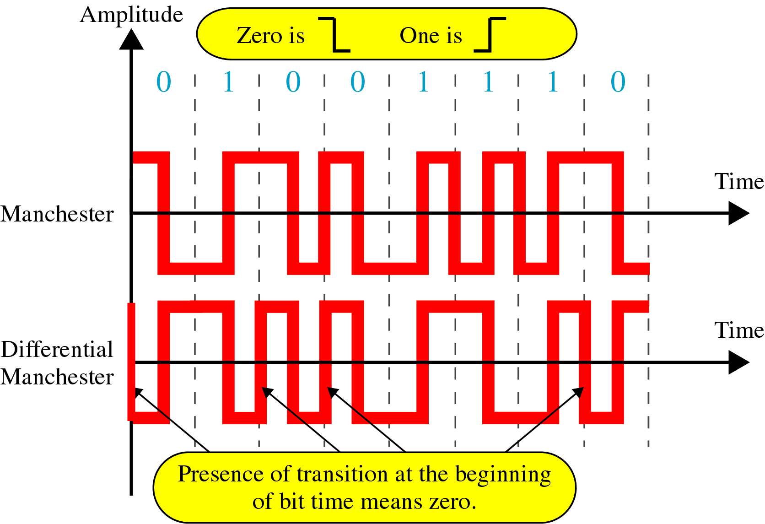
Figure 5-8
Manchester and Diff. Manchester Encoding

Slide 30
Manchester encoding : the duration of bits is divided into two halves. The voltage remains at one level during the first half and moves to the other level in the second bit.
A negative to positive transition represents binary 1 and a positive to negative transition represents binary 0.

